Slide 1
Economic & Concrete Supports, Family Well-being, and Reducing Risk for Child Welfare Involvement
North Carolina Economic Supports Conference
July 2023

Slide 2
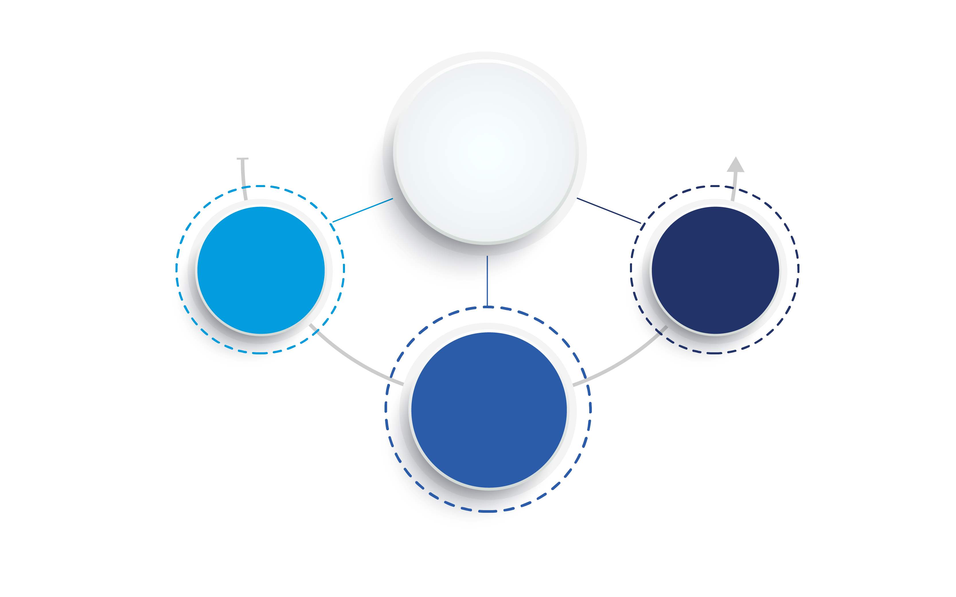
Economic and Concrete Supports (ECS): An Overview
Reduced access to ECS associated with INCREASED risk of child maltreatment & child welfare involvement
Increased access to ECS associated with DECREASED risk of child maltreatment & child welfare involvement
Economic & Concrete Supports
ECS evidence is consistent across time & types of studies:
Pelton, 1978 to
Pac et al, 2023
ECS evidence is ACTIONABLE
ECS evidence is
consistent across mechanisms:
cash assistance, child care, housing, health care, employment
supports, etc.

Slide 3
Context Matters: Impact of Historical & Contemporary Policy Choices
Overloaded & Destabilized Families
Unmet Service & Support Needs​
High Rates of Reported Neglect
Deployment of Authority to Investigate & Remove Children
Child Welfare Involvement
Disparate Access to & Lack of Sufficient Economic & Concrete Supports
Fragmented Human Service System
Deficit-Based Rigid & Piecemeal Policies
Mandated Reporting Laws
Economic Hardship

Slide 4
County-Level Relationship between Child Poverty Rates & CPS Reporting Has Intensified
The county-level relationship between child poverty rates and child protective services reporting rates intensified almost linearly from 2009 to 2018:
almost 40 % increase in the poverty-reporting relationship
“To the degree that our findings can be replicated, they could be interpreted as supporting an increased emphasis on reducing child maltreatment incidents and reports through poverty amelioration efforts and the provision of material family supports.”
(Kim & Drake, 2023)

Slide 5
nearly 85% of families investigated by child protective services have incomes below 200% of the federal poverty line ($49,720 for a family of 3 in 2023)
(Dolan, 2011 - National Survey of Child & Adolescent Well-Being II Baseline Report)
(HHS Poverty Guidelines, 2023)

Slide 6
60%+ of substantiated CPS responses nationally involve neglect only …and provision of economic & concrete supports is associated with decreased risk for both neglect and physical abuse
(Child Maltreatment 2019)

Slide 7
Context & Economic Factors Matter
Economic factors are associated with neglect outcomes above individual-level parenting behaviors & capacities
Material hardship is associated with CPS involvement beyond caregiver psychological distress & parenting factors
The association of individual factors (such as caregiver substance abuse or mental health) with child maltreatment is reduced after accounting for poverty experienced by families receiving preservation services
“…when the effects of poverty are accounted for, these individual factors lose their potency…”
(Slack, 2011)
(Yang, 2015)
(Escaravage, 2014)

Slide 8
Material Hardship Increases Risk for Child Welfare Involvement: Both Neglect & Abuse
If low-income families experience at least one material hardship
~3x higher likelihood of neglect investigation
~4x higher likelihood physical abuse investigation
If low-income families experience multiple types of material hardship (after experiencing no hardships)
~4x higher likelihood of CPS investigation
~7x higher likelihood physical abuse investigation
(Yang, 2015)
*Dimensions of material hardship in this study included: food, housing, utilities & medical hardship

Slide 9
Negative Earnings Shocks Are Associated with Increased Risk for Subsequent Child Welfare Involvement (slide 1 of 2)
For low-income families with recently closed CPS investigations:
Experiencing a negative earnings shock (quarterly reduction in earnings of 30% or more):
Increases risk of subsequent CPS investigation by 18%
Increases risk of physical abuse investigation by 26%
Each additional negative earnings shock is associated with a 15% greater likelihood of CPS involvement
But each consecutive quarter with stable income is associated with a 5% lower risk of CPS investigation
About 10% of low-income adults with children have experienced a financial shock resulting in a 50% income drop over one year
(Cai, 2021)

Slide 10
But the Association Diminishes When Negative Earnings Shocks Are Offset by Public Benefits (slide 2 of 2)
For low-income families with recently closed CPS investigations:
Accessing sufficient public benefits when negative earnings shocks occur effectively buffers against the risk of child welfare involvement
Buffer is particularly strong for families with young children (ages 0–4), who are associated with a:
12% decrease in risk for CPS involvement
50% decrease in risk for physical abuse investigation
(Cai, 2021)

Slide 11
The Intersection of Family Economic Insecurity & Child Welfare Involvement
Most reliable economic predictors of child welfare involvement
Strongest predictors of
investigated neglect reports
Income Loss
Cumulative Material Hardship
Short duration of residence
Food pantry use
Cutting meals
Housing Hardship
Inability to receive medical care for sick family member
Difficulty paying rent
Utility shutoffs
Public
benefit receipt
(Conrad-Hiebner, 2020
systematic review)
(Slack, 2011
cross-study comparison)

Slide 12
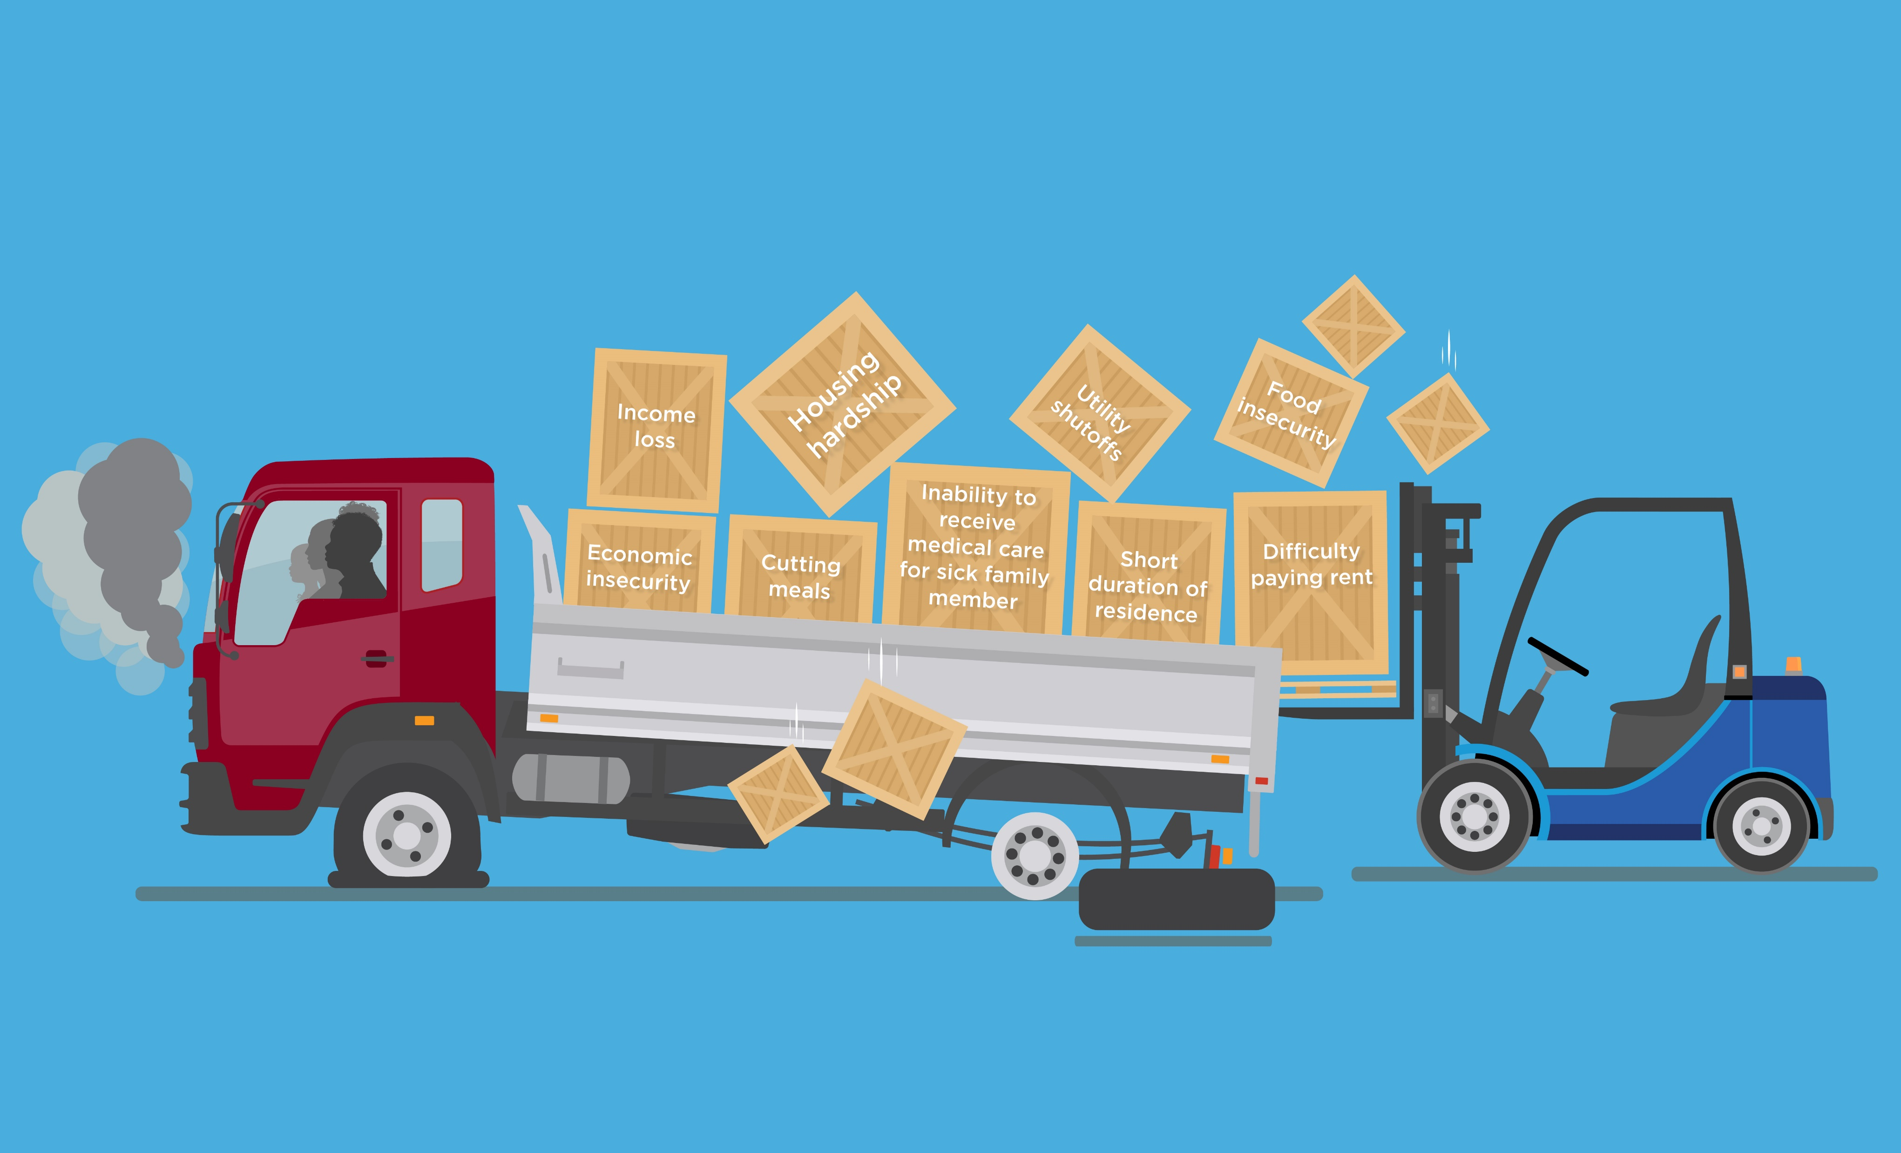
Multiple Material & Economic Hardships Can Overload Families
Multiple Material & Economic Hardships Overload Families and
Increase Risk for Child Welfare Involvement
Watch the Overloaded Parents Video by NSPCC
Visual created by Chapin Hall at the University of Chicago
Adapted from: (Conrad-Hiebner, 2020) (Slack, 2011) (Sweetland, 2021)

Slide 13
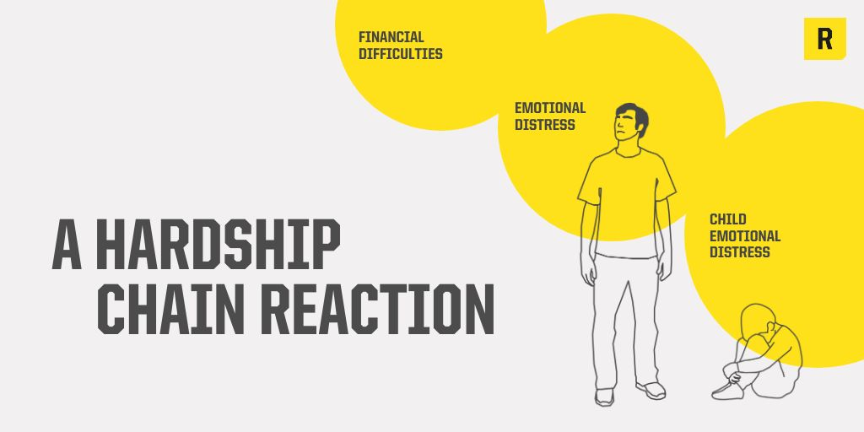
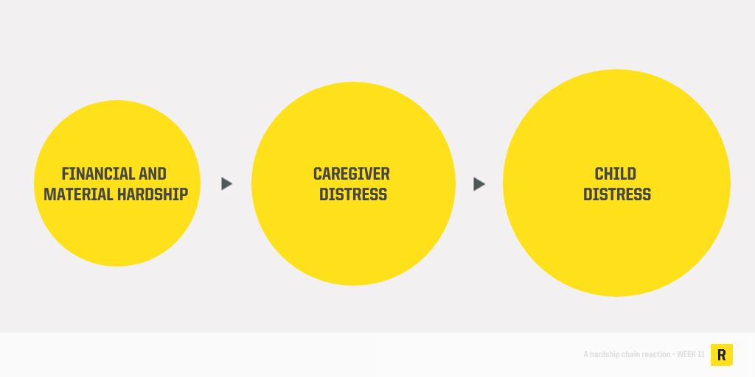
A Hardship Chain Reaction
Evidence demonstrates a chain reaction of hardship, in which material hardship is directly associated with an increase in parents’ emotional distress (depression, anxiety, loneliness & stress symptoms) which is, in turn, associated with an increase in child emotional distress (fussiness, fearfulness & anxiety).
(RAPID Stanford Center on Early Childhood, 2023)

Slide 14
Families who Experience Child Welfare Call for Increased Economic & Concrete Resources
We share our lived experiences and perspectives with national, state and community leaders to transform the child welfare system and to raise awareness about the need for increased prevention strategies and resources for families before serious problems occur.
Birth Parent National Network & Casey Family Programs Birth Parent Advisory Committee
(CTF Alliance, 2020)

Slide 15
Economic & Concrete Support Packages (NAS) to Improve Context and Prevent Child Welfare Involvement
National Academy of Sciences Consensus Report (2019)
A Roadmap to Reducing Child Poverty
Anti-poverty package 2: expansion of EITC & Child and Dependent Care Tax Credit (CDCTC ) + universal monthly child allowance
Anti-poverty package 3: expansion of EITC, CDCTC, Housing Choice Voucher Program & SNAP
Anti-poverty package 4: expansion of EITC & CDCTC, increase in federal minimum wage (to $10.25/hr) + monthly child allowance
Analysis simulating the effects of increased household income under 3 anti-poverty policy packages found these could reduce CPS investigations by 11 to 20% annually (386,000 to 669,000 fewer children investigated per year)
Reductions were particularly large for Black and Latinx children & those living with single parents
Analysis suggests implementation would substantially reduce racial disproportionality in CPS involvement:
19 to 29% reduction in investigations for Black children
13 to 24% reduction in investigations for Latinx children
7 to 13% reduction in investigations for white children
(Pac, 2023)
(A Roadmap to Reducing Child Poverty, 2019)

Slide 16
CPS Interventions Are Pervasive: Over Half of All Black Children Experience an Investigation
37% of all children and 41% of children in the 20 most populous U.S. counties experience at least one CPS investigation by age 18
3 million children experience a CPS investigation or alternative response each year (FFY 2021)
From 2006-2019, there were almost 30 million CPS-investigated reports in the US
An estimated 1 in every 100 children experience a termination of parental rights
(Berger, 2020 - graphic)
(Kim, 2017) (Edwards, 2021)
(Child Maltreatment 2021) (Wildeman, 2020) (Austin, 2023)

Slide 17
Evidence: Relationship between Economic & Concrete Supports and Child Welfare Involvement

Slide 18
Sources of Evidence
How do the following studies show the impact of programs, policies, and strategies for reducing child welfare system involvement through economic & concrete supports?
Theoretical models and studies that illustrate the processes by which material hardship leads to child maltreatment
Research designed to detect the impact of a specific strategy through randomized controlled trials (RCT)
Analysis of decades of administrative data aligned with policy or other shifts
Natural experiments to assess public benefit programs
This vast body of science and growing preponderance of evidence informs our understanding of what has been effective and why and hypotheses about potential policy shifts & new pathways.
*Unless otherwise noted, all findings presented are statistically significant

Slide 19
Decreased Access to Economic & Concrete Supports Is Associated with Increased Child Welfare Involvement
Reduced TANF benefits
Reduced income & negative earnings shocks
Increased risk for child welfare involvement
Lack of child care
Reduced employment
Lack of stable housing
Increased gas prices
(Ginther, 2017) (Ginther, 2022) (Paxson, 2003) (Yang, 2016) (Cash, 2003)
(Klevens, 2015) (Brown, 2020) (Berger, 2011) (Warren, 2015) (Cai, 2021)
(Weiner, 2020) (McLaughlin, 2017) (Bullinger, 2021) (Berger, 2015)
(Frioux, 2014) (Wood, 2012)

Slide 20
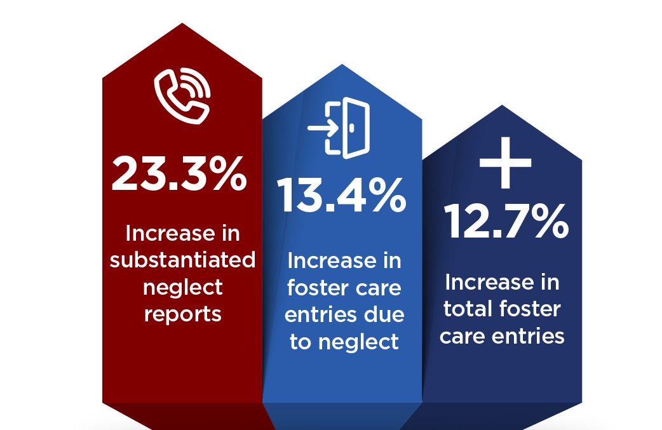
Lack of Access to Temporary Assistance to Needy Families (TANF)
Reminder: The first statutory goal of TANF is to support needy families so that children can remain safely at home or with relatives.
States that imposed total benefit loss as the most severe sanction for not meeting TANF work requirements:
(Ginther, 2017)
(Increases observed from 2004 to 2015)

Slide 21
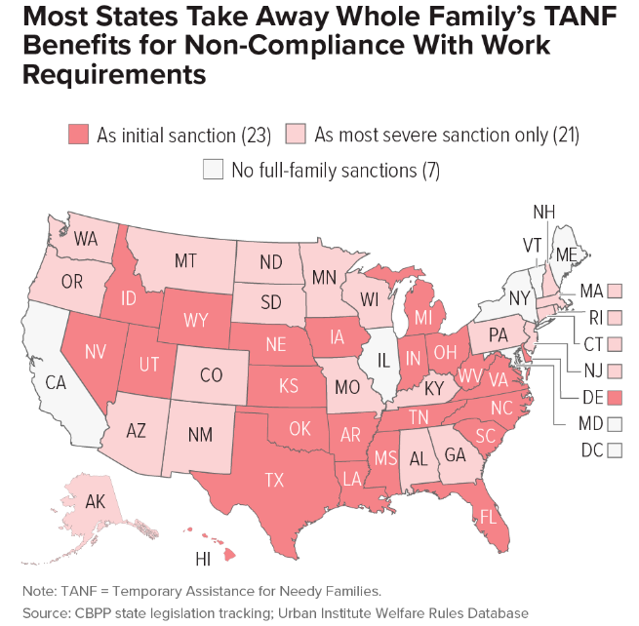
State Policy Option: No Full-Family Sanctions for Non-Compliance with TANF Work Requirements
Nearly half of states take away TANF benefits from the entire family (“full-family sanctions”) as the initial punishment if a parent does not meet work requirements
States with higher concentrations of Black residents have a higher likelihood of imposing full-family sanctions
(as of 2021)
(Center on Budget & Policy Priorities (CBPP), 2021)

Slide 22
Lack of Access to Child Care
For every additional child care concern reported by families receiving TANF, the risk of supervisory child neglect increases by 20%
Mothers entering substance use treatment who have difficulty securing child care are 82% more likely to self-report child neglect (compared to mothers entering treatment who don’t have this difficulty)
Difficulty finding child care was a stronger predictor of maternal neglect than almost any other factor measured in this study, including mental health & severity of drug use
(Yang, 2016)
(Cash, 2003)

Slide 23
Reduced Employment
During the Great Recession (2007–2009), the rate of abusive head trauma (AHT) for children < 5 years old was considerably higher than during the period immediately before
AHT rate increased from 8.9 in 100,000 children before the recession to 14.7 in 100,000 children during the recession
(Berger, 2011)

Slide 24
Increased Access to Economic & Concrete Supports
Is Associated with Decreased Risk for Child Welfare Involvement
Macroeconomic Supports
Concrete Supports
Tax credits (EITC & CTC)
Employment
Minimum wage
Paid family leave
Unemployment benefits
Healthcare (Medicaid)
Home visiting with ECS
Child care & pre-K
Housing
Public Benefits
Child Welfare Interventions with ECS
Overall state spending on benefits
TANF
SNAP & WIC
Differential response
Family preservation

Slide 25
Evidence of Causal Effect of Income on Risk for Child Welfare Involvement
Mothers who participate in TANF and are eligible to receive full child support for their children (and child support is disregarded in determining welfare benefits) are 10% less likely to have a child subject to a screened-in maltreatment report
(compared to mothers who are eligible to receive only partial child support payments)
Even a modest increase in child support payments—averaging $100 per year—results in a decrease in screened-in maltreatment reports
(Cancian, 2013)
(randomized controlled trial - RCT)

Slide 26
Macro-Economic & Employment Supports

Slide 27
Earned Income Tax Credit (EITC)
States with a state-level refundable EITC, compared to those without, are associated with an 11% decrease in foster care entries (even after controlling for poverty, race, education & unemployment)
If states without any EITC implemented a refundable EITC, an average of 668 fewer children would enter foster care annually in each state
(Rostad, 2020)

Slide 28
Earned Income Tax Credit (EITC)
10% increase in the generosity of refundable state-level EITC benefits is associated with:
5% decline in reported maltreatment rates
9% decline in reported neglect rates
Refundable state-level EITC (averaging $400 per year) is associated with a 13% decrease in hospital admissions for abusive head trauma for children < 2 years old* (even after controlling for poverty, race, education & unemployment)
(Kovski, 2022)
(Klevens, 2017)
* Approaches statistical significance

Slide 29
State Policy Option: Establish a State Earned Income Tax Credit
26 states, D.C., Guam & Puerto Rico have a refundable EITC
(as of August 2022)
(NCSL, 2022)

Slide 30
Minimum Wage
From 2004 to 2013:
States that increased the minimum wage beyond $7.25 per hour experienced a decline in child maltreatment reports
Every $1 increase in minimum wage was associated with a 9.6% decline in neglect reports (primarily for children < 12 years)
(Raissian, 2017)

Slide 31
Minimum Wage
Increasing a city’s minimum wage is associated with reductions in self-reported physical & psychological aggression by parents towards their children
(compared to cities that do not change minimum wage)
(Schnieder, 2021)

Slide 32
State Policy Option: Establish or Increase Minimum Wage
18 states + D.C. have adopted minimum wages of $12 or higher
The current federal minimum wage of $7.25 per hour is now worth less than at any point since 1956
A worker paid the current federal minimum wage earns 40% less than a minimum wage worker in 1968
(as of January 2023)
(EPI, 2023 - graphic)
(EPI, 2022)

Slide 33
Paid Family Leave (PFL)
Compared to states with no PFL policy, the implementation of California’s 2004 PFL policy (up to 12 weeks of partially paid leave) was associated with a decrease in hospital admissions for abusive head trauma:
among children <1 year old and
among children < 2 years old
(Klevens, 2016)

Slide 34
State Policy Option: Establish Paid Family Leave Policies
Less than 1 in 4 workers have access to paid family leave
11 states + D.C. have adopted a statewide paid family leave program (but not all are fully implemented)
(as of 2022)
(Prenatal-to-3 Policy Impact Center (PN3), 2022 - graphic) (KFF, 2021)

Slide 35
Unemployment Benefits
States that extended the duration of unemployment benefits at the onset of the Great Recession saw smaller increases in substantiated neglect reports
(compared to states that didn’t extend unemployment benefits)
(Brown, 2020)​

Slide 36
State Policy Option: Expand Unemployment Benefits
Only two states provide more than 26 weeks of unemployment benefits
(as of November 2022)
(CBPP, 2022- graphic)

Slide 37
Concrete Supports: Home Visiting & Child Care

Slide 38
Universal Home Visiting with Economic & Concrete Supports
Family Connects (FC) is a short-term, community-wide nurse home visiting program for families with newborns
Focuses on addressing material needs: 1–3 home visits to assess family needs, connect families to community resources, and provide education & intervention as needed
Randomized clinical trials of all families with births in select hospitals in Durham, NC over a 6-month period found that families randomly assigned to FC experienced:
More positive maternal mental health (at age 6 months)*
44% lower rate of CPS investigations (through age 2)
39% fewer CPS investigations (through age 5)
(compared to families who didn’t receive FC)
“The findings… suggest that, when implemented with high quality & broad reach, a brief postpartum nurse home visiting program can reduce population rates of child maltreatment .”
(Goodman, 2021)(RCT)
(Dodge, 2019)(RCT)
* Approaches statistical significance

Slide 39
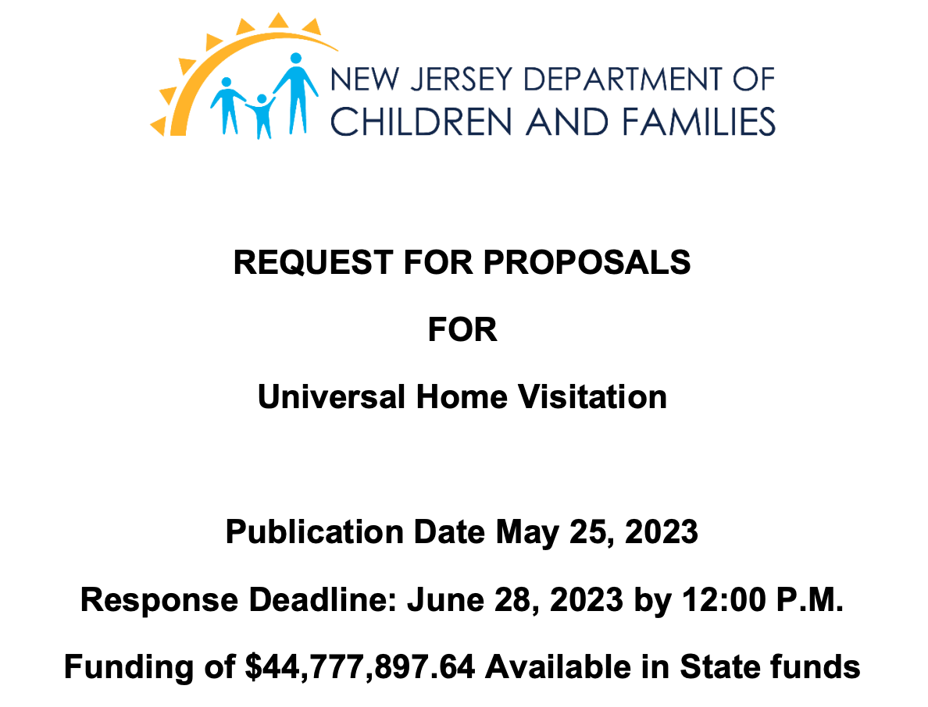
State Policy Option: Fund Universal Home Visiting to Prevent Child Welfare Involvement at the Population Level
Family Connects
Provided at no cost, on a voluntary basis to families of all backgrounds & incomes
Available to birth, adoptive & resource families with a newborn, and parents experiencing a stillbirth
(NJ RFP, 2023)

Slide 40
Child Care Subsidies
States with Child Care & Development Fund (CCDF) program policies that make child care subsidies more accessible to child welfare-supervised families are associated with lower child removal rates
(compared to other states)
(Meloy, 2015)

Slide 41
Child Care Subsidies
Consolidated Appropriations Act of 2023 included a 30% increase in funding for the Child Care & Development Block Grant (CCDBG)
Each additional month that mothers who are low income receive a child care subsidy is associated with:
16% decrease in the odds of a neglect report
14% decrease in the odds of a physical abuse report
(in the following 12 months)
(Yang, 2019)

Slide 42
Child Care
Child care investments* included in Build Back Better (proposed 2020-2021) would be associated with a:
6.4% reduction in CPS investigations
6% reduction in substantiated child maltreatment
3.1% reduction in foster care placements
11.6% reduction in child fatalities due to maltreatment
*$273 billion for child care for children up to age 5
$109 billion for free and universal preschool
(Puls, 2022)

Slide 43
High-Quality Child Care
Reduces likelihood of child welfare involvement
Children who attended Early Head Start had fewer child welfare encounters between ages 5 and 9 (compared to those who didn’t attend)
Reduces likelihood of foster care entry
Children (ages 0–5) who participated in Head Start & were referred to child welfare for suspected maltreatment were 93% less likely to enter foster care (compared to children who did not receive any early childhood education service)
Helps prevent child maltreatment
Children who participated in Chicago Child-Parent Center preschool:
52% less likely to be victims of confirmed maltreatment by age 17
Lower rates of reported neglect
(compared to non-participating peers)
Less than one-third of young children under child welfare supervision who live at home receive any early childhood education services
(Reynolds, 2003) (Green, 2014) (Klein, 2017)

Slide 44
State Policy Option: Increasing Access to Child Care for Families
New Mexico
From 2022 to 2023, child care will be free for most families (family of four earning up to about $111,000)
Goal is to develop a free, universal child care system
In November 2022, New Mexico overwhelmingly approved a ballot measure guaranteeing a constitutional right to early childhood education
It will create a dedicated funding stream (from the state’s Land Grant Permanent Fund) for universal preschool and child care & bolster home-visiting programs for new parents

Slide 45
Concrete Supports: Health

Slide 46
Medicaid Expansion
The rate of screened-in neglect reports for children < age 6 decreased in states that expanded Medicaid, but increased in states that did not expand Medicaid (from 2013 to 2016)
If non-expansion states had expanded Medicaid, there would have been almost 125,000 fewer screened-in neglect referrals for children < age 6 in the U.S. (from 2014 through 2016)
Medicaid expansion is associated with improved economic stability & mental health for parents who are low income
(Brown, 2019)

Slide 47
Medicaid Expansion
States that newly expanded Medicaid in 2014 were associated with reductions in the average rate of child neglect reports per state-year:
13% reduction for children ages 0-5
15% reduction for children ages 6-12
16% reduction for children ages 13–17
(compared to states that did not expand Medicaid from 2008 to 2018)
North Carolina expanded Medicaid in 2023
(McGinty, 2022) (Urban Institute, 2021)

Slide 48
Policy Synergy: Medicaid Expansion & Housing Stability
Medicaid expansion is a key strategy for addressing housing instability for people with low incomes
Evictions fell by 20% in Medicaid expansion states compared to non-expansion states
By providing enrollees with financial protection from high medical bills, Medicaid can free up income to pay rent or to avoid eviction
(Zewde, 2019) (CBPP, 2022 - graphic)

Slide 49
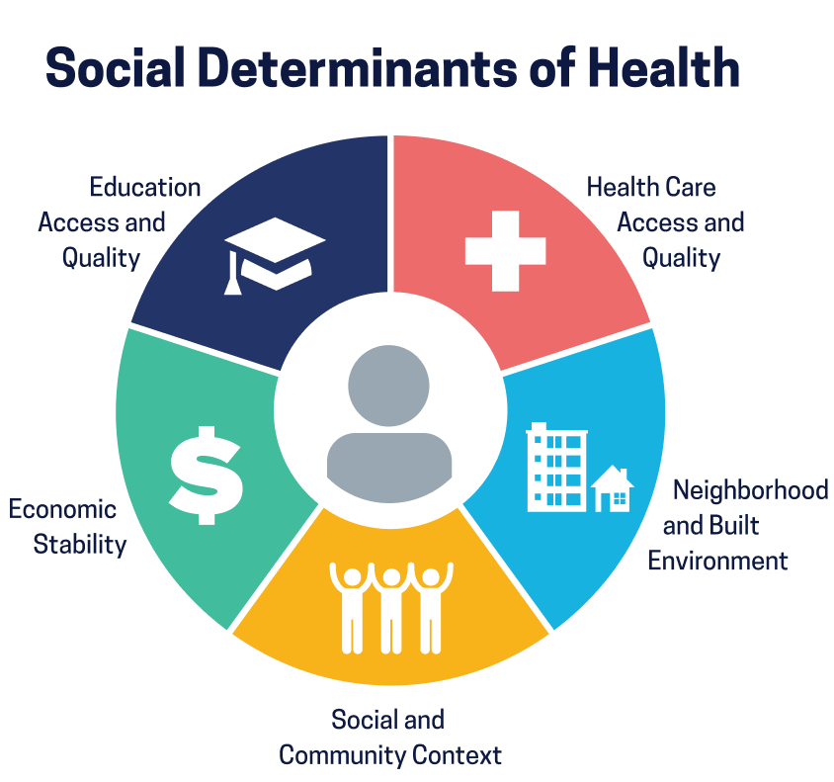
State Policy Option: Leverage Opportunities to Use Medicaid Funding to Address Social Determinants of Health
North Carolina – Healthy Opportunities (2022)
California – CalAIM (2022)
Oregon – Oregon Health Plan (2022)
Medicaid waivers shifting to a population health approach prioritize prevention & social determinants of health
Provide non-medical supports related to housing, food & transportation for those with complex needs
Improve individual & community health
(KFF, 2022)

Slide 50
Concrete Supports: Housing

Slide 51
Supportive Housing
Children of child welfare-involved families who face housing instability and receive a supportive housing program (housing voucher + case management) experience:
Fewer removals (9% vs. 40% in business- as-usual control group after 2 years)
Lower prevalence of substantiated maltreatment (8% vs. 26% in control group after 18 months)
Increased reunification (30% vs. 9% in control group after 2 years)
(Farrell, 2018) (RCT)

Slide 52
Permanent Housing Subsidies
HUD’s Family Options Study found that homeless families referred for permanent housing subsidies self-reported:
50% fewer foster care placements
(1.9% vs. 5% in the control group experienced at least 1 placement in the last 6 months)
Lower rates of psychological distress
Less intimate partner violence
Fewer child behavior problems
Greater housing stability & food security
(compared to a business-as-usual control group of homeless families at the 20-month follow-up)
(Gubits, 2015) (RCT)

Slide 53
State Policy Option: Connect Head Start Families to Housing Supports
Connecticut
Head Start on Housing Program (2022)
Cross-agency collaboration that provides federal housing vouchers to families with young children participating in Head Start programs

Slide 54
State Policy Option: Provide Short-Term Housing Support to Families Involved with Child Welfare
Wisconsin – Family Keys Pilot Program (2022)
Provides short-term housing funds to families with children at risk of removal due to housing insecurity & to families unable to reunify due to inadequate housing
Short-term housing funds will be used for hotel costs, short-term rentals & expenses related to finding and maintaining housing (security deposits, housing application fees, utility costs)

Slide 55
Public Benefits

Slide 56
Temporary Assistance to Needy Families (TANF)
Easing TANF restrictions is associated with:
Fewer children with substantiated neglect
Fewer children placed into foster care
TANF policy choices reviewed in this study included:
Time limits of less than 60 months
Severe sanctions for not meeting work requirements
Work requirements for mothers with children < 12 months
Suspicion-based drug testing of applicants
An estimated 29,112 fewer children would have entered foster care nationally from 2004 to 2016 if states had eased TANF restrictions to increase access for families
(Ginther, 2022)

Slide 57
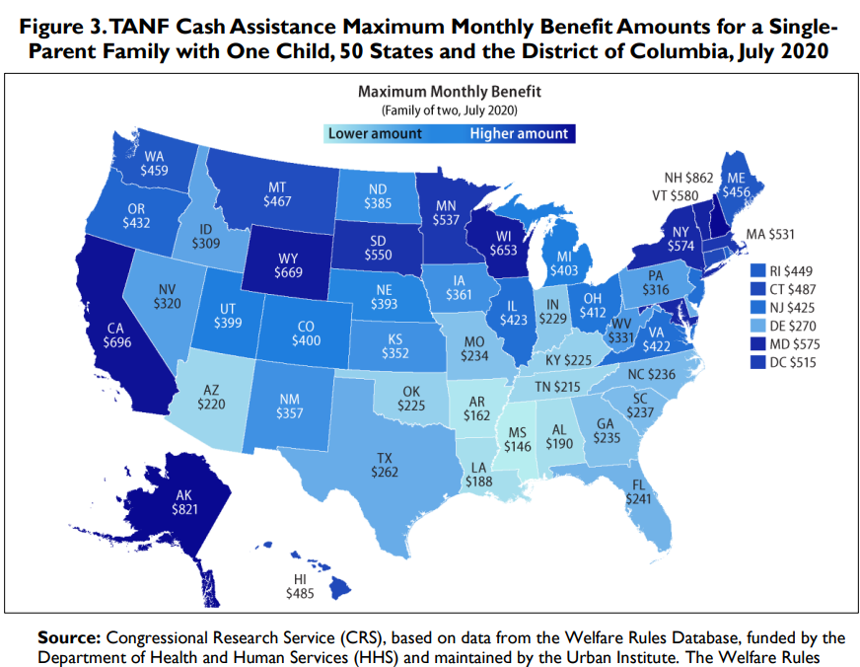
State Policy Option: Increase TANF Cash Assistance Benefit Amounts
TANF cash benefit amounts are determined solely by states
For a family of 2, maximum benefit amount varies from $146 to $862 per month (as of July 2020)
Only two states have a maximum benefit amount > 50% of the federal poverty line (FPL)
Although several states increased cash benefit amounts in 2021, benefits in most states remain at their lowest value since the program was created in 1996
48% of Black children live in states with benefit amounts below 20% of the FPL, compared to 35% of white children
(CRS, 2022)
(CBPP, 2023)

Slide 58
State Policy Option: Provide Concrete Supports through TANF Home Visiting Program
California – SB 187 (effective 2022)
Increases the amount from $500 to $1,000 for a one-time payment for the purchase of material goods to families participating in the TANF home visiting program

Slide 59
Supplemental Nutrition Assistance Program (SNAP) (slide 1 of 2)
States with more generous SNAP policies experienced:
Large reductions in CPS reports
(reduction of 352 reports per 100,000 children*)
Fewer substantiated reports, particularly for neglect
Fewer foster care placements
(from 2004 to 2016, compared to states with less generous SNAP policies)
(Johnson-Motoyama, 2022)
*(95% CI, -557.1 to -148.2)

Slide 60
Supplemental Nutrition Assistance Program (SNAP) (slide 2 of 2)
From 2004 to 2016:
Every 5% increase in the number of families receiving SNAP benefits was associated with an 8% to 14% reduction in CPS & foster care caseloads
Cumulative effect: implementation of multiple more generous SNAP policies was associated with larger reductions in child welfare involvement
Estimated reductions in CPS reports & substantiations were particularly large among states offering transitional SNAP benefits to families leaving TANF
(Johnson-Motoyama, 2022)

Slide 61
State Policy Option: Implement More Generous SNAP Policies
Adoption of More Generous SNAP Policies Over Time
SNAP policy choices reviewed in this study:
Increasing income limits under broad-based categorical eligibility (BBCE)
Excluding legally obligated child support payments from total income
Providing transitional SNAP benefits to families leaving TANF
Using simplified reporting option for changes in household circumstances
(Johnson-Motoyama, 2022 - graphic)

Slide 62
Child Welfare Programs with Economic & Concrete Supports

Slide 63
Family Preservation with Concrete Supports
Families with open child welfare cases (mostly neglect) who receive a home-based services program with concrete supports are 17% less likely to experience a subsequent child maltreatment report (during the first year)
(compared to families who receive the program without any concrete supports)
(Rostad, 2017)

Slide 64
State Policy Option: Provide Concrete Supports through Family Preservation Program
Kentucky
Two policies make available either $1000 or $4000 for concrete supports to meet needs to reduce involvement with child welfare.
For families receiving preservation services, up to $5000 is available.
From 2019 to 2023
Prevention investment of $11.4 million
Out-of-home care costs reduced by $79.1 million
(decline in out-of-home costs includes significant decrease in number of children in foster care & reductions in congregate care placements)
(Kentucky Interim Joint Committee on Health, Welfare & Family Services, July 21, 2021)

Slide 65
Cross-Sector Considerations

Slide 66
Economic & Concrete Supports As a Population-Level Strategy for Prevention of Child Maltreatment
Public benefit programs included in this analysis:
Cash, housing & in-kind assistance
Low-income housing infrastructure development
Child care assistance
Refundable EITC
Medical assistance programs (including Medicaid + CHIP)
Each additional $1,000 that states spend annually on public benefit programs per person living in poverty is associated with:
4% reduction in child maltreatment reports
4% reduction in substantiated child maltreatment
2% reduction in foster care placements
8% reduction in child fatalities due to maltreatment
(independent of federal spending)
(Puls, 2021, state-level data FFY 2010–2017)

Slide 67
Economic & Concrete Supports As a Population-Level Strategy for Prevention of Child Maltreatment
In 2017, if all states had increased investment in public benefit programs by 13.3% there would have been an estimated:
181,850 fewer child maltreatment reports
28,575 fewer substantiations
4,168 fewer foster care placements
130 fewer child fatalities due to maltreatment
Long-term cost savings:
Each additional 13.3% that states invest annually in public benefit programs (which would total $46.5 billion nationally) would save up to $153 billion due to reduced maltreatment-related costs
(Puls, 2021, state-level data FFY 2010-2017)

Slide 68
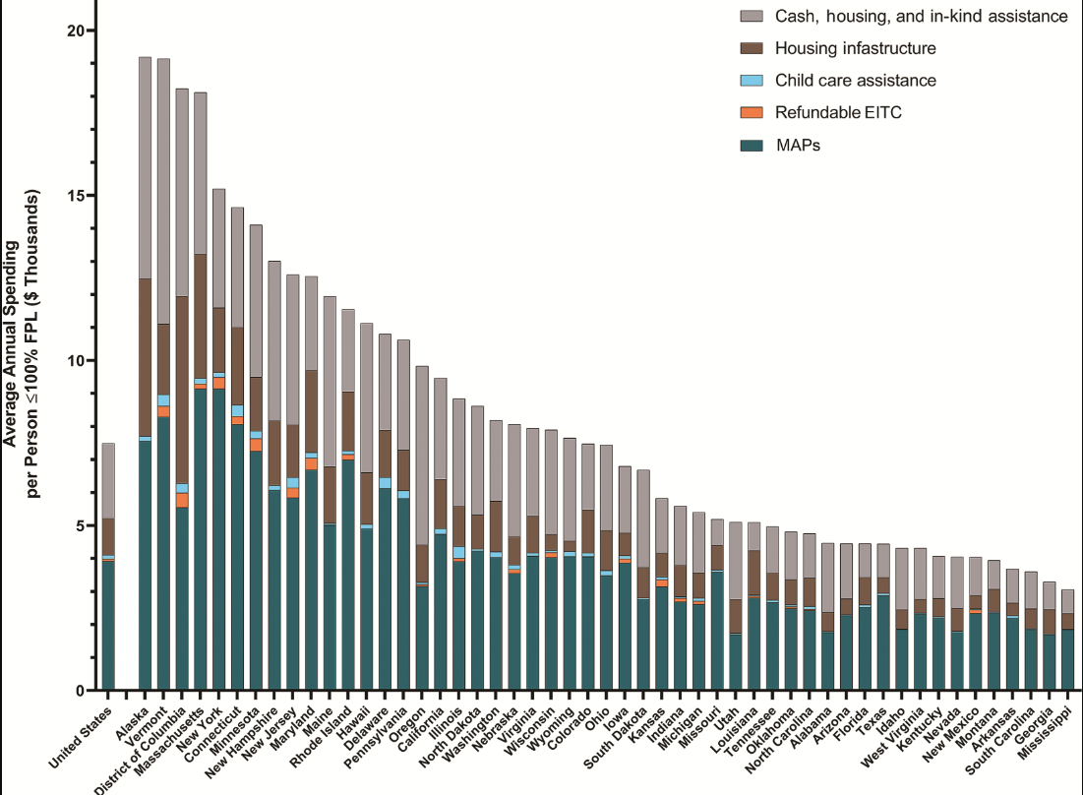
State Policy Option: Level & Mix of State Spending on Public Benefits Per Person Living in Poverty
States’ total annualized spending on public benefit programs per person living in poverty
(FFY 2010 – 2017)
North Carolina spends below national average
(Puls, 2021 - graphic)

Slide 69
Benefits to Society of Increasing Household Income
(Garfinkel, 2023)

Slide 70
Annual Costs of Child Maltreatment in the U.S.
$80 billion = direct & indirect costs of child maltreatment (2012)
$428 billion = economic burden due to substantiated child maltreatment (lifetime costs incurred annually) (2015)
$2 trillion = economic burden due to investigated child maltreatment (lifetime costs incurred annually) (2015)
(Gelles, 2012)
(Peterson, 2018)

Slide 71
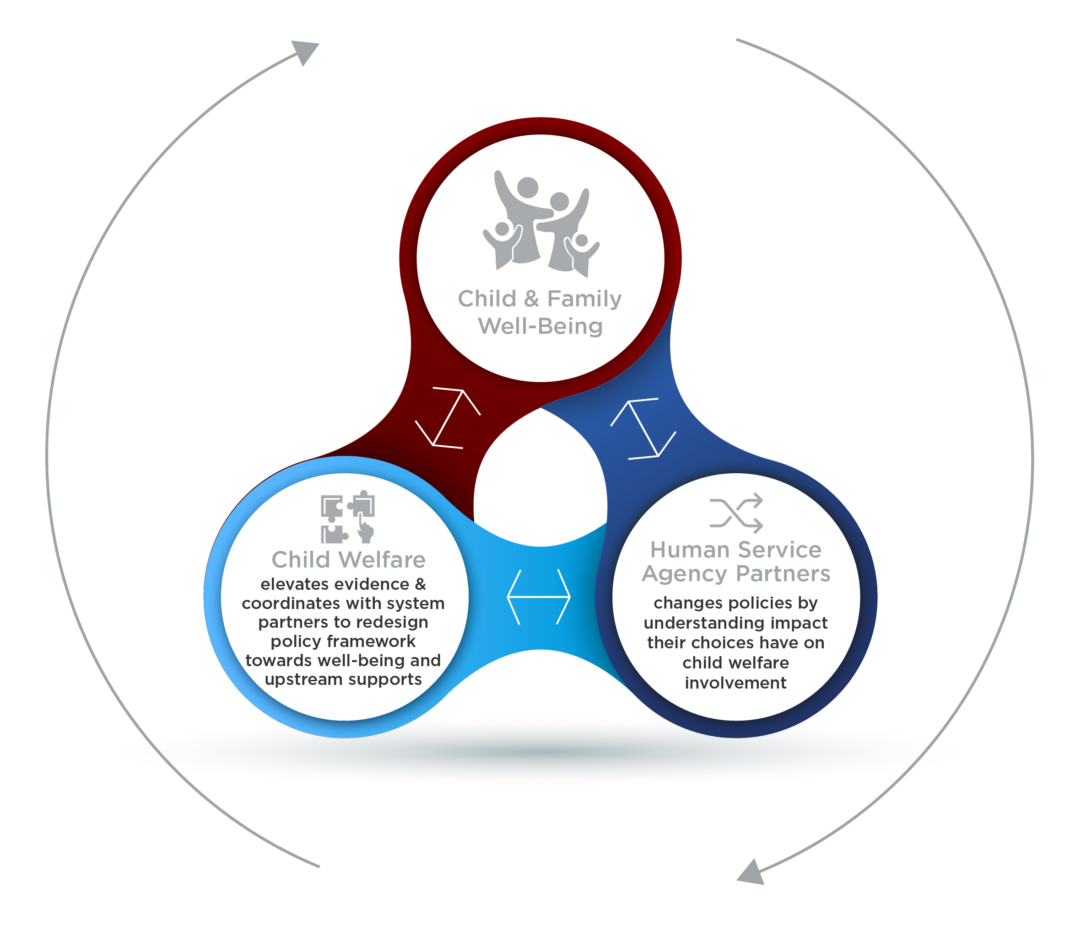
Evidence-based Policy-Making to Build a Well-Being System: Making it ACTIONABLE
Equitable policy, program & service design centering the experiences and leadership of families, youth & communities
States take a holistic well-being approach to policy making focused on preventing child welfare involvement & high human and fiscal costs

Slide 72
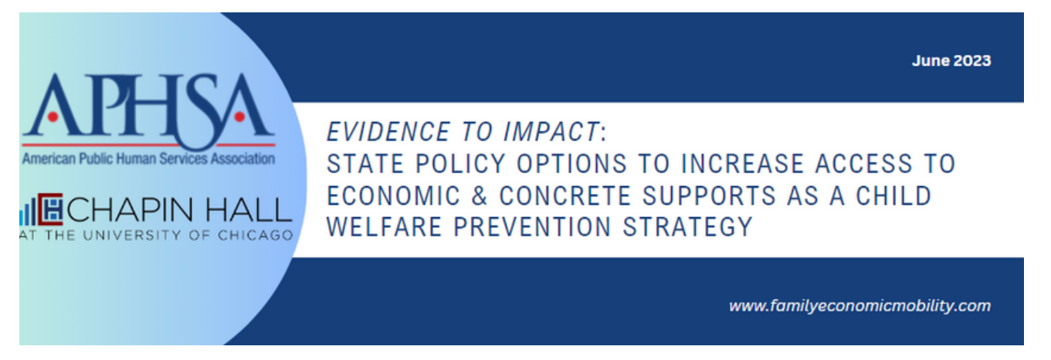
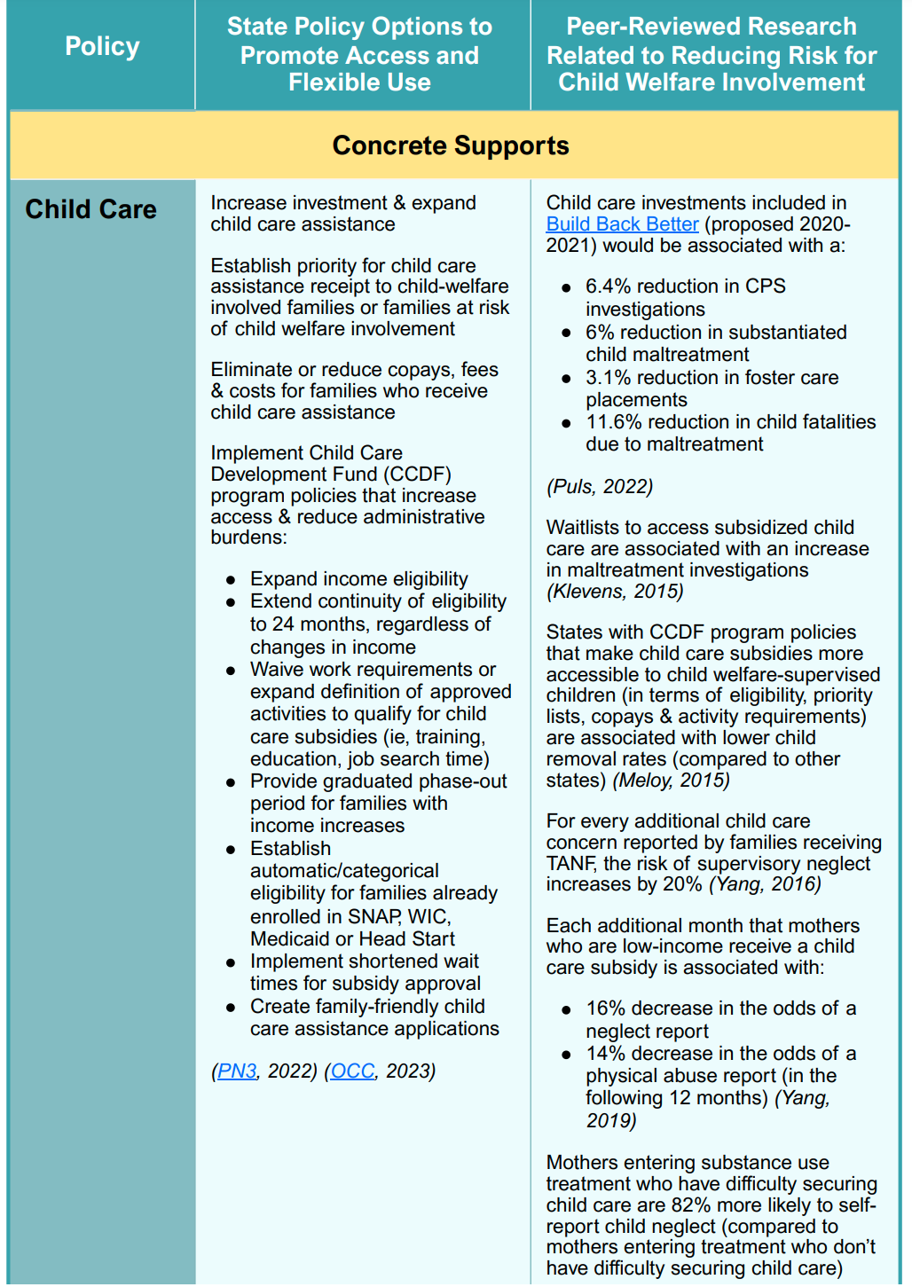
APHSA & Chapin Hall Policy Analysis Tool
https://www.chapinhall.org/wp-content/uploads/FINAL-ECS-Tool-with-Intro_6.14.23.pdf

Slide 73
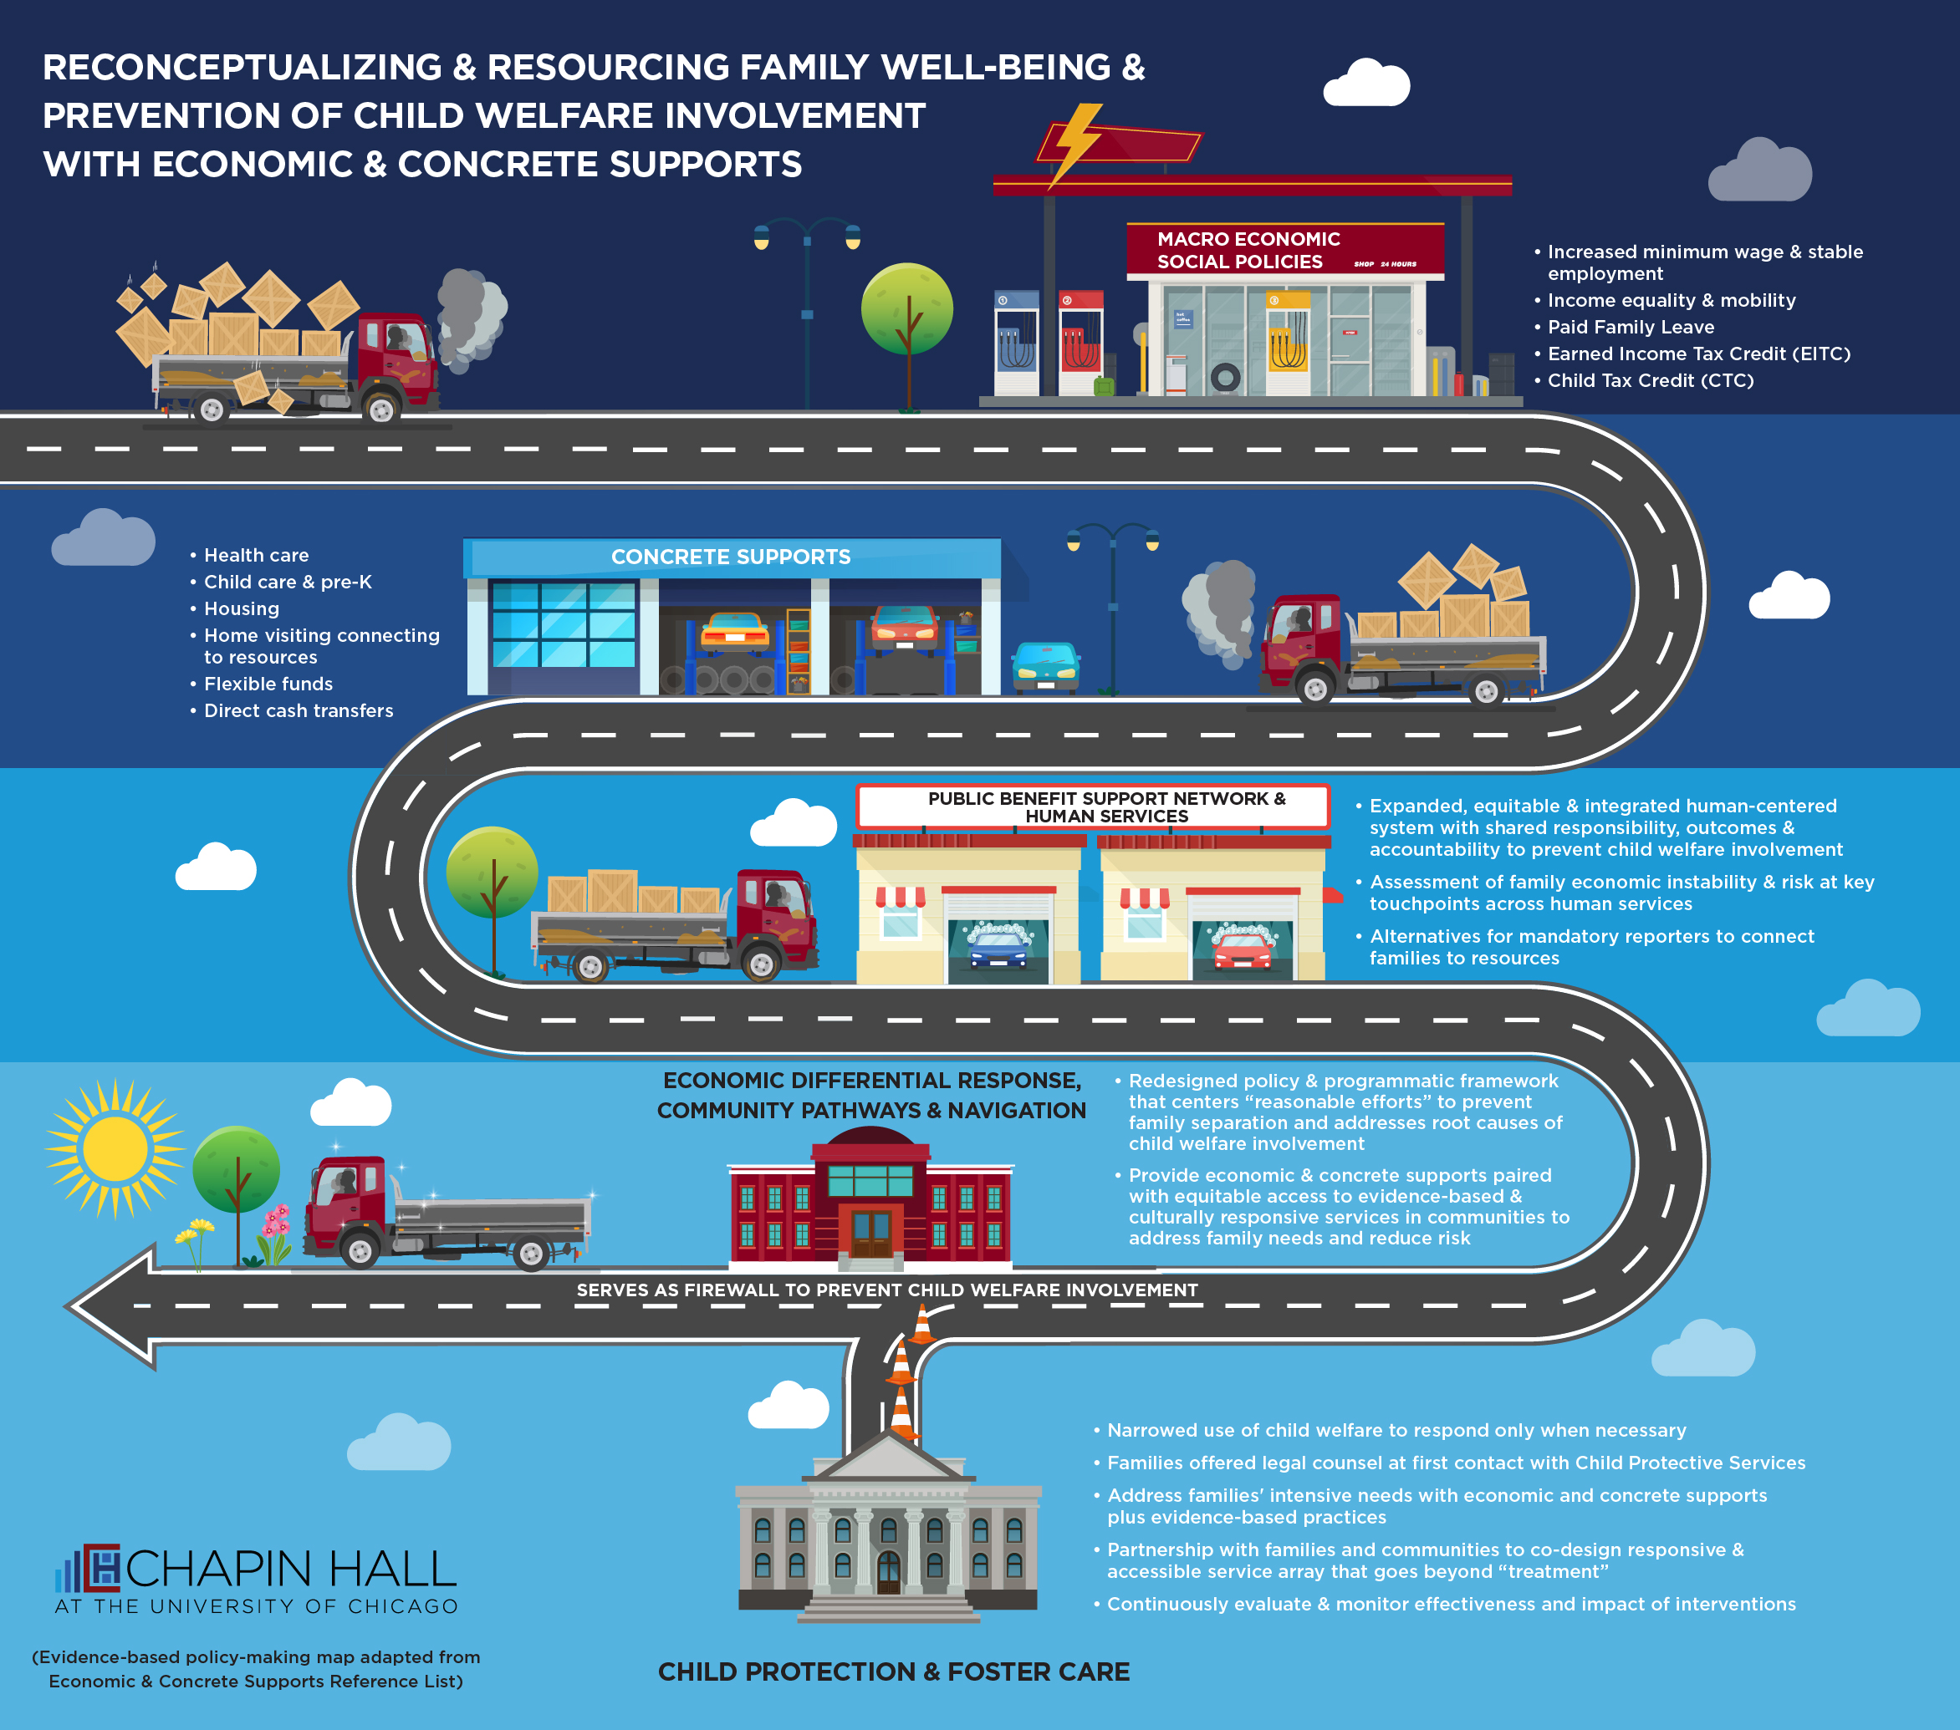

Slide 74
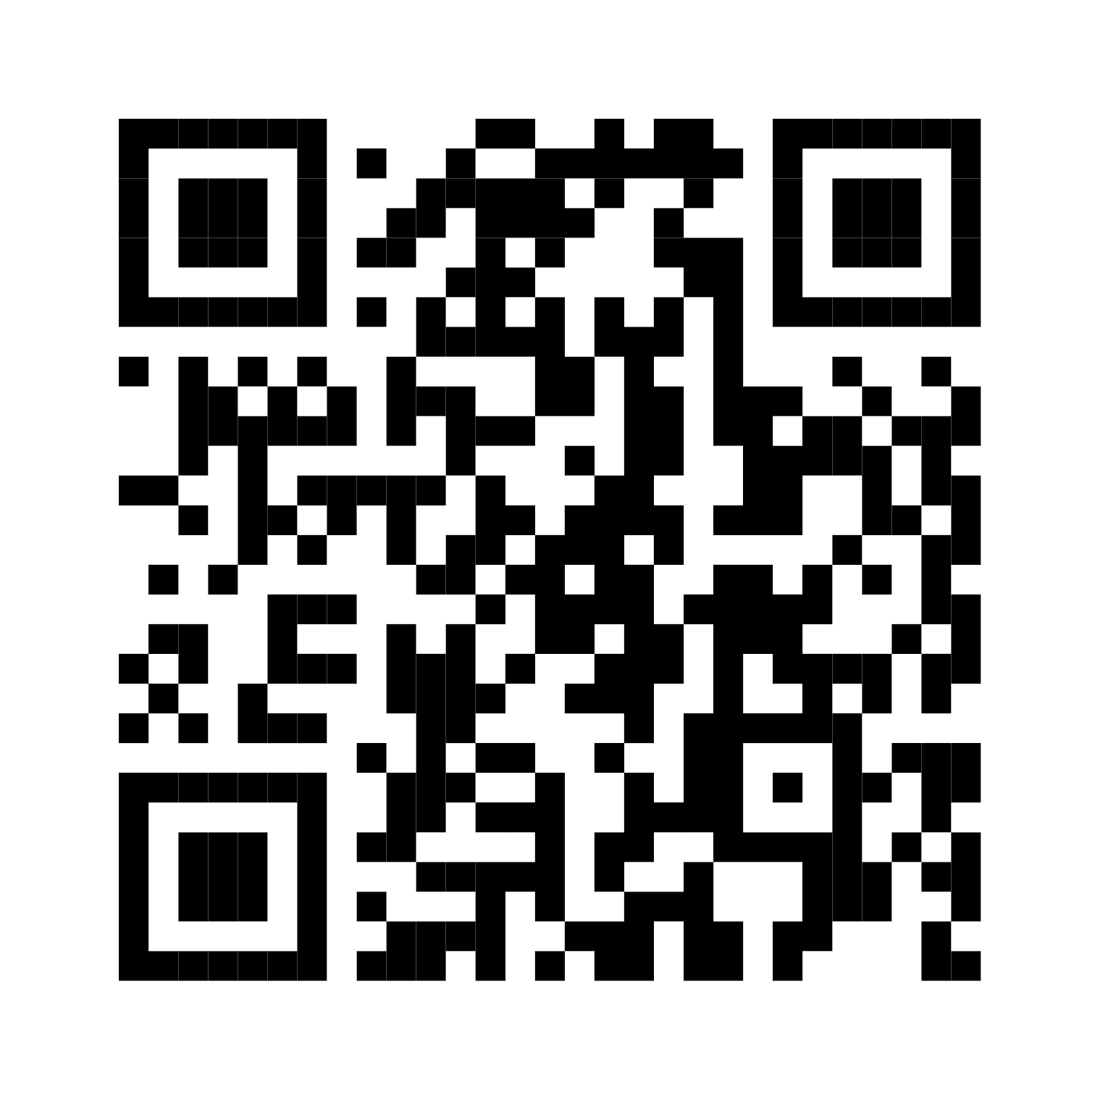
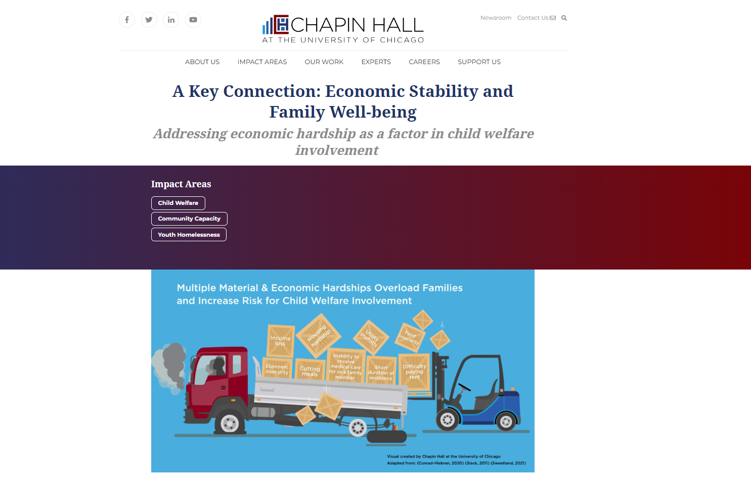
Chapin Hall Resources
Chapinhall.org/ecsproject
(Weiner, Anderson & Thomas, 2021)
(Anderson, Grewal-Kök, Cusick, Weiner & Thomas, 2021)
Notes:
Weiner, D. A., Anderson, C., & Thomas, K. (2021). System transformation to support child and family well-being: The central role of economic and concrete supports. Chicago, IL: Chapin Hall at the University of Chicago.

